Slide 1
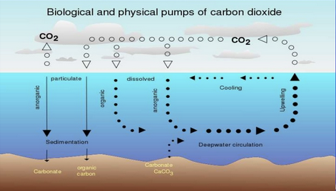
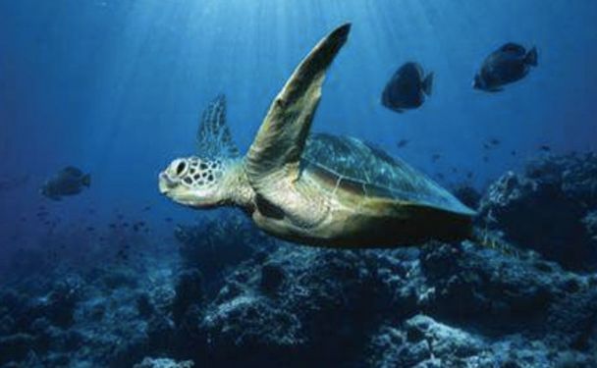
Ocean Acidification
Mr Dhue

Slide 2
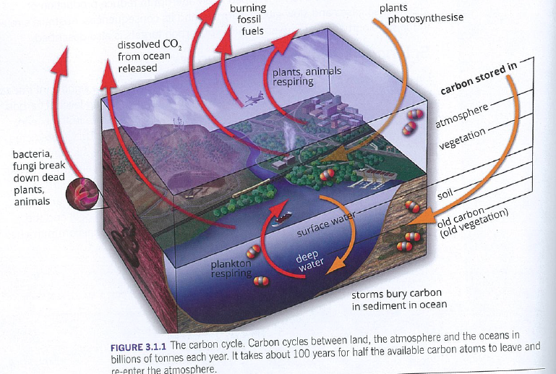
Previously known… Carbon Cycle

Slide 3
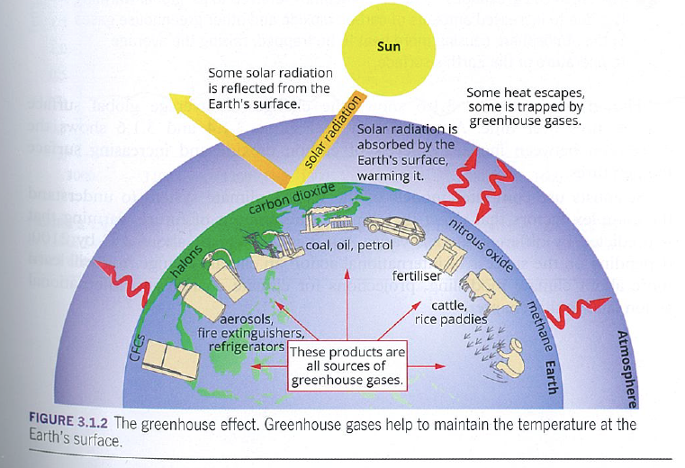
The Greenhouse Effect
Greenhouse gases include, water vapour (H₂O), carbon dioxide (CO₂), methane (CH₄), nitrous oxide (N₂O) and ozone (O₃).
Some is good, too much is bad.

Slide 4
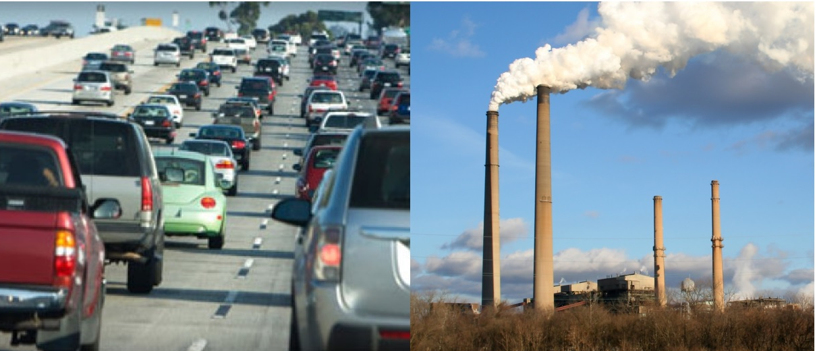
Human activity is speeding up the build up of CO₂
Transportation, industry and things we do at home, like use electricity, have contributed to rising CO₂ emissions to the atmosphere

Slide 5
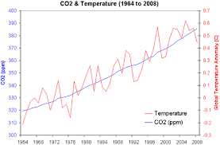
Increased CO₂ produces higher temperatures
There is a strong correlation between rising CO₂ levels and rising global temperatures.
Global warming.

Slide 6
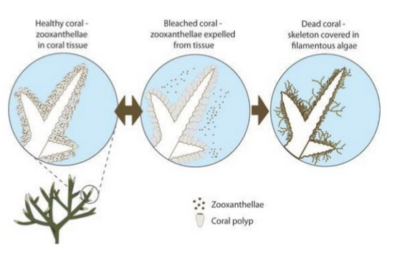
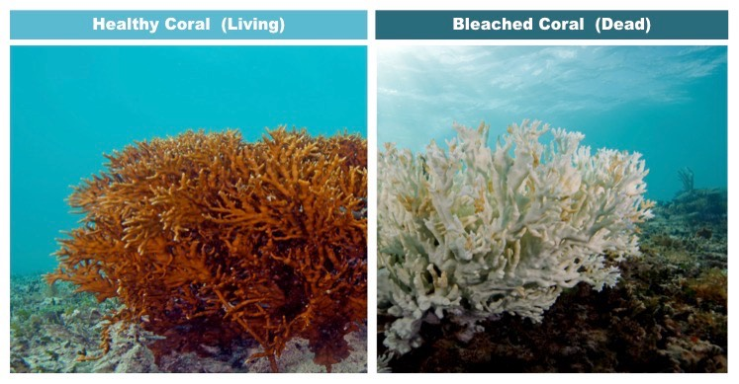
Bad news for corals
Corals rely on a symbiotic relationship with colourful algae to help produce their food
At higher temperatures these corals expel the algae leading to “bleaching”

Slide 7
Carbon is an important part of ocean chemistry
The ocean absorbs carbon dioxide from the atmosphere in an equilibrium system
Human activities release carbon dioxide into the atmosphere
This can cause a shift in the equilibrium
Too much carbon dioxide in the ocean has the potential to harm marine organisms and ecosystems

Slide 8
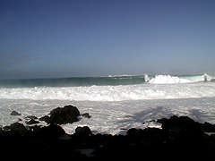
The ocean is a carbon sink
The ocean absorbs CO₂ from the atmosphere
Physical and biological processes move some of the carbon to the deep ocean where it is stored
The capture and
storage of carbon
is known as
carbon sequestration
Photo: NOAA

Slide 9
Human Impacts…
It is believed that between one third and one-half of the CO₂ emissions from human activities are absorbed by the oceans.
This does reduce the impact on the green house effect in the atmosphere but does effect the oceans by changing the pH and concentrations of dissolved species.
This can have effects on coral reefs, fish stocks, algae, food chains etc.

Slide 10
Atmospheric CO₂ dissolves in the ocean
CO_{2 (g)} ⇋ CO_{2 (aq)}
Equilibrium shift (ie amount dissolved) decreases with increasing temperature, however, increases with increasing CO₂ partial pressure.
This dissolved CO₂ forms the weak carbonic acid
CO_{2 (aq)} + H₂O _{(l)} ⇋ H₂CO_{3 (aq)}

Slide 11
Bad news for the pH
The carbonic acid ionises in two steps (diprotic) an equilibrium that produces H⁺ ions in solution.
H₂CO_{3 (aq)} ⇋ HCO₃⁻ _{(aq)}+ H⁺ _{(aq)}
HCO₃ ⁻_{(aq)} ⇋ CO₃²⁻ _{(aq)}+ H⁺ _{(aq)}
Another equilibrium exists between the Calcium carbonate in the sea floor sediments (dead shells etc)
CaCO_{3 (s)} + H⁺ _{(aq)} ⇋ Ca²⁺ _{(aq)} + HCO₃⁻ _{(aq)}

Slide 12
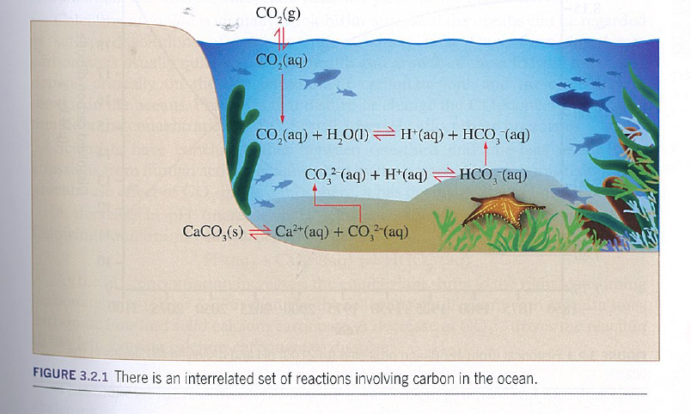

Slide 13
The equilibrium maintains a system that can resist small changes (We do buffers later in the year)
The majority of the inorganic carbon in the ocean exists as bicarbonate ions (HCO₃⁻). Very little H₂CO₃ exists in solution.
Sea water maintains a pH of 8.2 due to the limestone (CaCO₃) that saturates the water with Ca²⁺ and CO₃²⁻ ions. The carbonate reacts with water making hydroxide ions.

Slide 14
Remember your pH scale
pH= -log[H⁺], so the lower the pH, the more H⁺
acidic
(high H⁺ )
basic
(low H⁺ )
neutral
0
7
14
Vinegar
~3
Ocean water
~8
Ammonia
~11

Slide 15
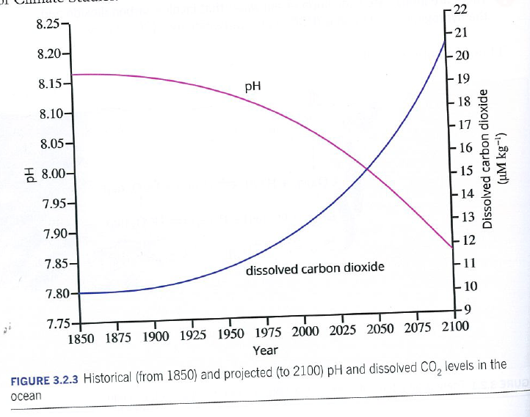
Ocean pH levels are decreasing
Data from scientists show that average ocean pH has decreased between the 1700s (pre-industry) and the 2000s (ie become more acidic)
Observations at monitoring stations across the ocean have shown this decreasing trend

Slide 16
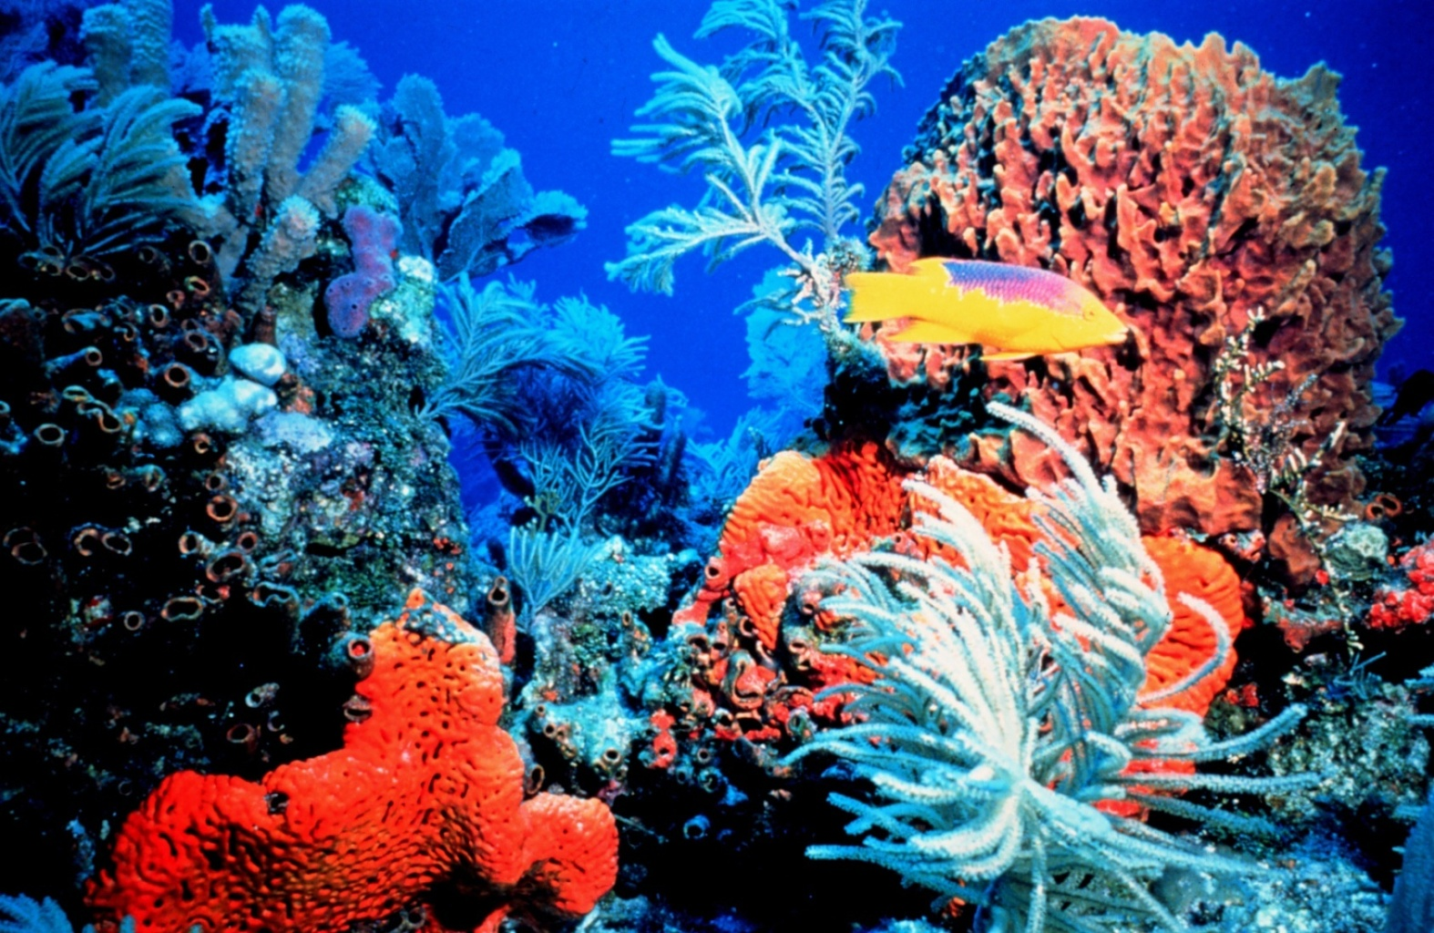
How is marine life affected?
Sensitive ecosystems like coral reefs may decline due to change in pH and slower construction of coral exoskeletons.
Photo: NOAA

Slide 17
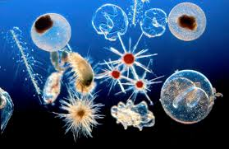
Decalcification
The H⁺ attacks the
CaCO₃ used by many
marine creatures to
form their skeletons.
Shells of marine life can begin to dissolve in high CO₂ concentrations.
Also the biological process to form shells requires more energy. They make less or weaker shells.
Decreases carbonate ion concentrations.
H⁺ _{(aq)} + CO₃²⁻ _{(aq)} ⇋ HCO₃⁻ _{(aq)}

Slide 18
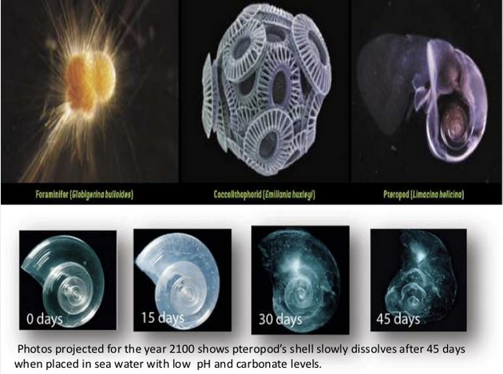

Slide 19
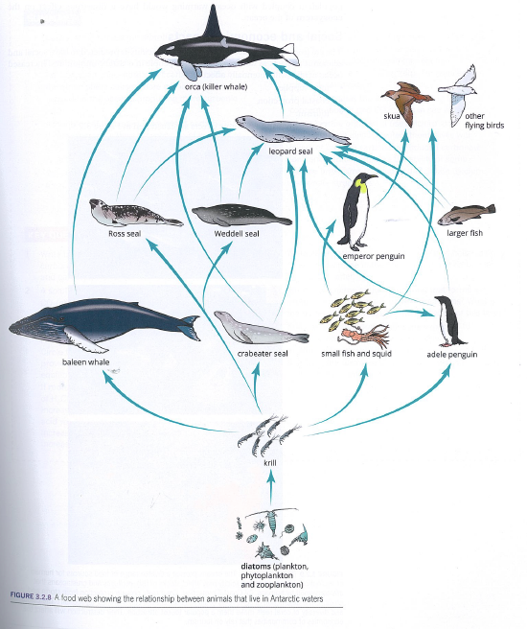
Marine Food Chains
Reduced abundance of small shelled organisms has an effect on the marine food chains.
Mainly plankton and krill at the bottom of the food chain
Larger species that prey upon them for food

Slide 20
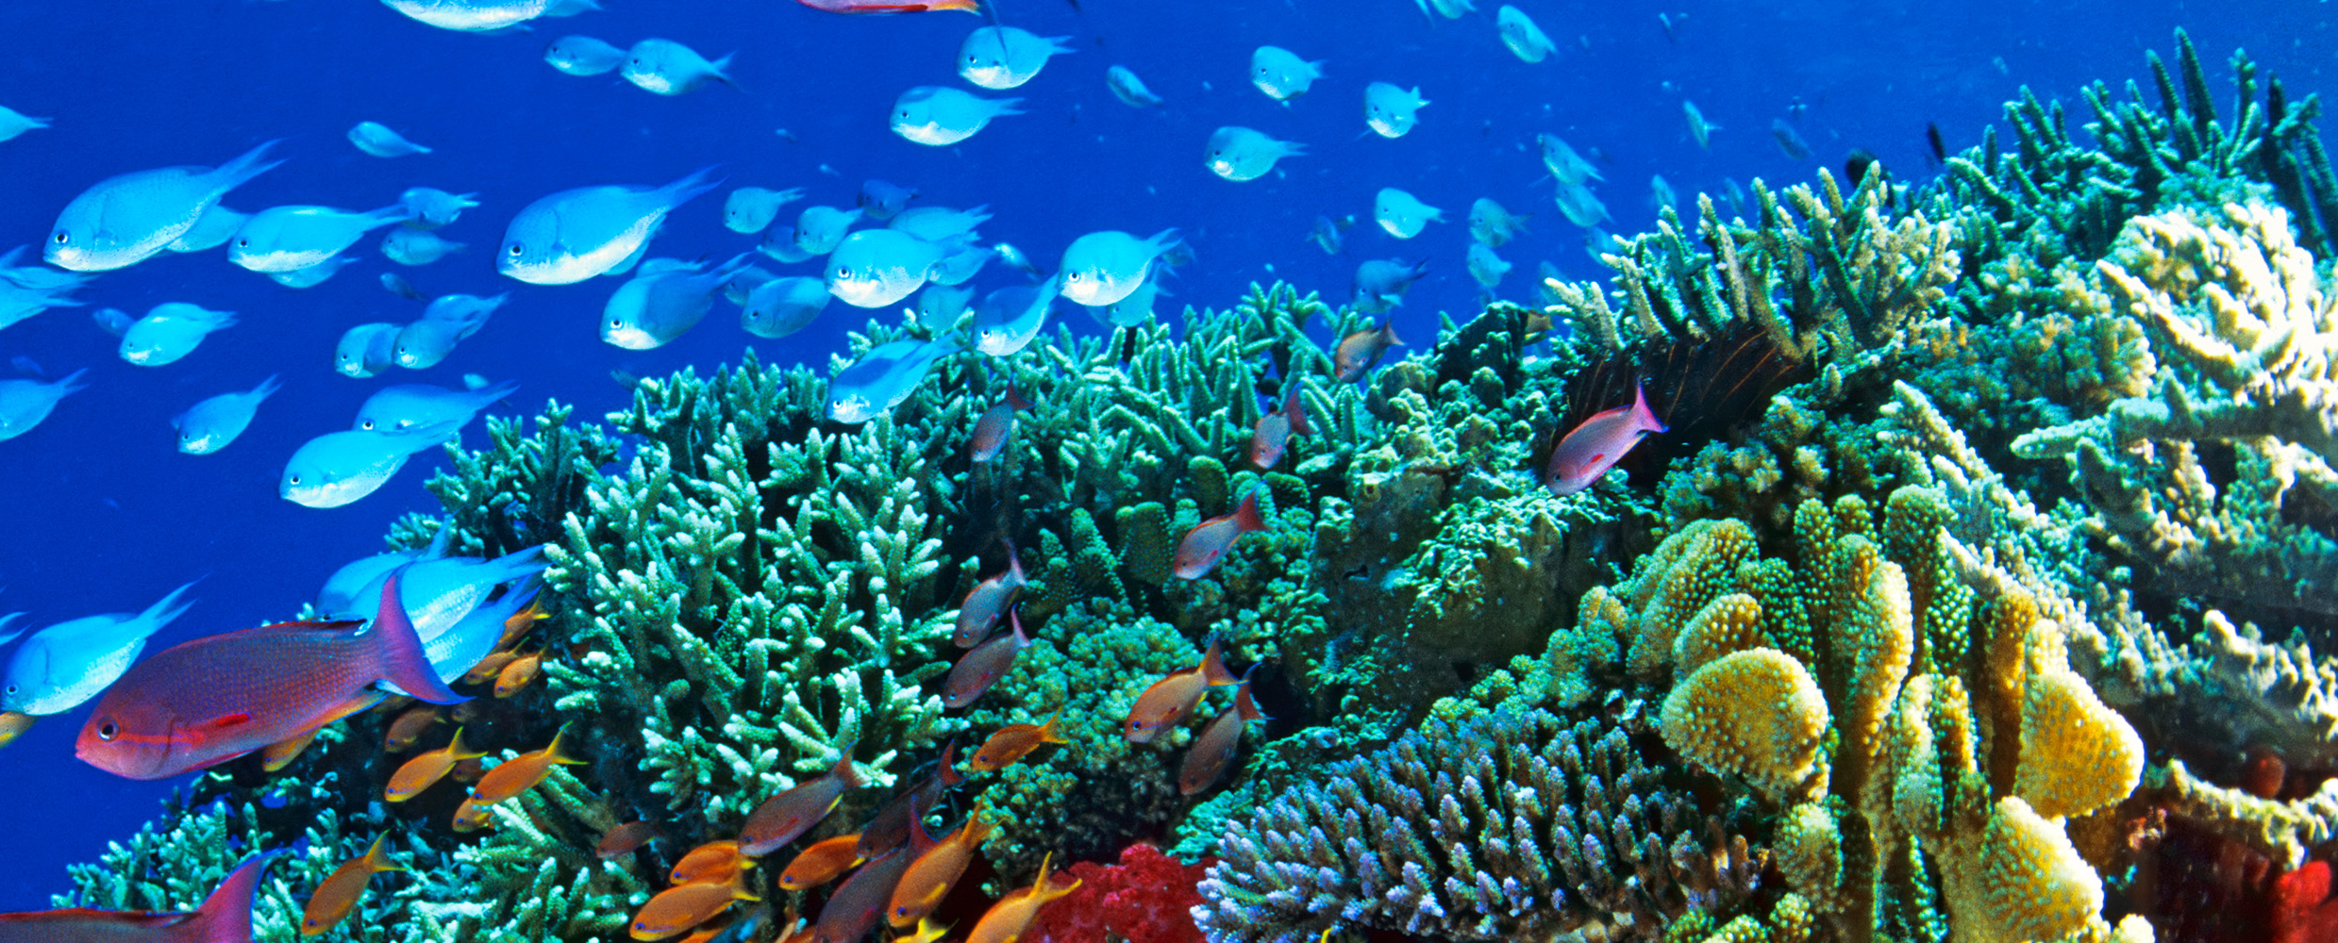
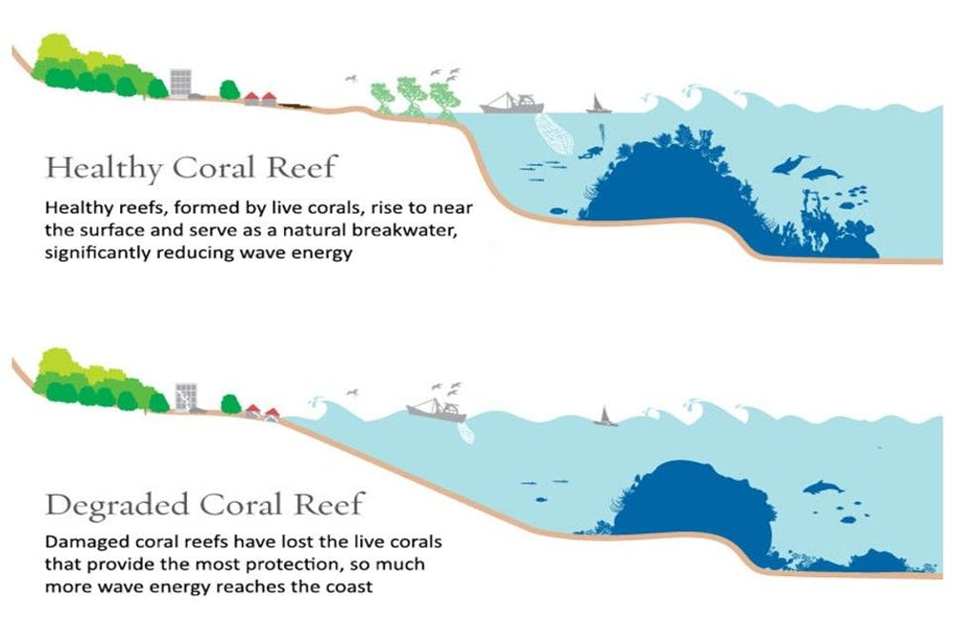
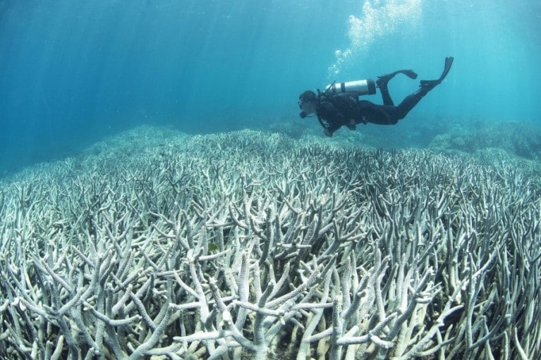
Social and Economic impacts
Less food supply – fish etc
Less costal protection with out reefs
Loss of Tourism

Slide 21
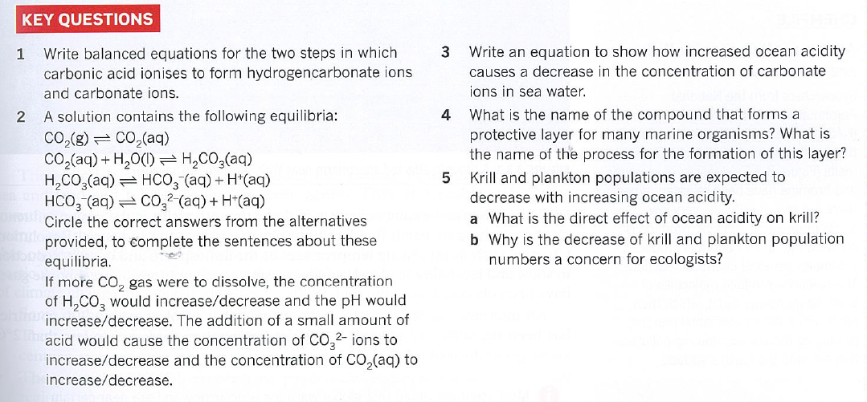

Slide 22
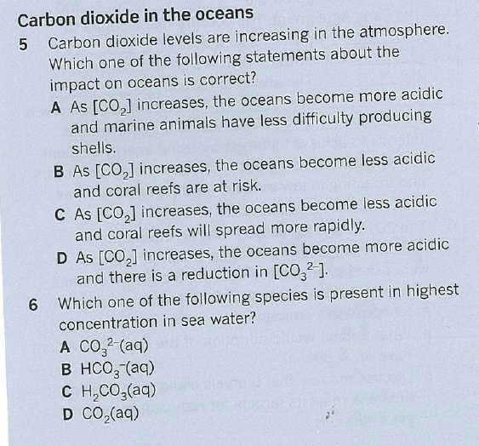

Slide 23
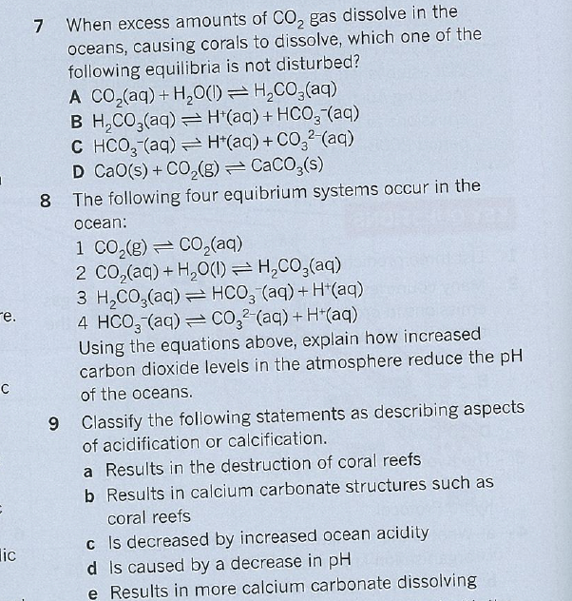

Slide 24
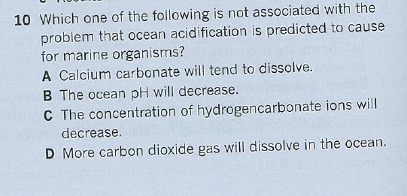

Slide 25
